Slide 1


PROJECT
STUDENT FEEDBACK
SYSTEM

Slide 2
Developed By:
Shrishti Vasudeva
Shivani Sharma
SaurabhTaneja
Shivam Miglani
Guided By:
Mr. Deepak Thakur

Slide 3
Project Statement & Problem Description :-
While time spent at college is a fond memory and a happy experience for most, the student life is not without its rough patches. Everyone's situation is unique, but there are a few problems that almost all college students deal with at least once during their time at school.
If you are on your way to college, get a jump on how to deal with the challenges that may come your way.

Slide 4
ACKNOWLEDGEMENT
It is our pleasure to be indebted to various people, who directly or indirectly contributed in the development of this work and who influenced my thinking, behavior and acts during the course of study.
We express our sincere gratitude to all for providing me an opportunity to undergo Integrated Project as the part of the curriculum.
We are thankful to “Mr. Deepak Thakur” for his support, cooperation, and motivation provided to us during the training for constant inspiration, presence and blessings.

Slide 5
INTRODUCTION:-
The Online Student Feedback System is:-
Automatic feedback generation system .
Provides proper feedback .
Creates a private portal for students.
Description of issues faced by Hostellers and Day Scholars.

Slide 6

The purpose of this project is to make the process of taking feedback from the students in online regarding the problems faced by them. With this, the institutes can access the feedback reports in a faster way and without any loss of data.

Slide 7
DESCRIPTION
Our website contains all the information and a questionnaire on the online feedback system.
It also helps students to identify and resolve student related issues.

Slide 8
TECHNOLOGY Used
FRONT END :-
HTML
JAVASCRIPT
JQUERY
CSS
BOOTSTRAP
BACK END:-
PHP

Slide 9

Day Scholars | Hostellers

Slide 10
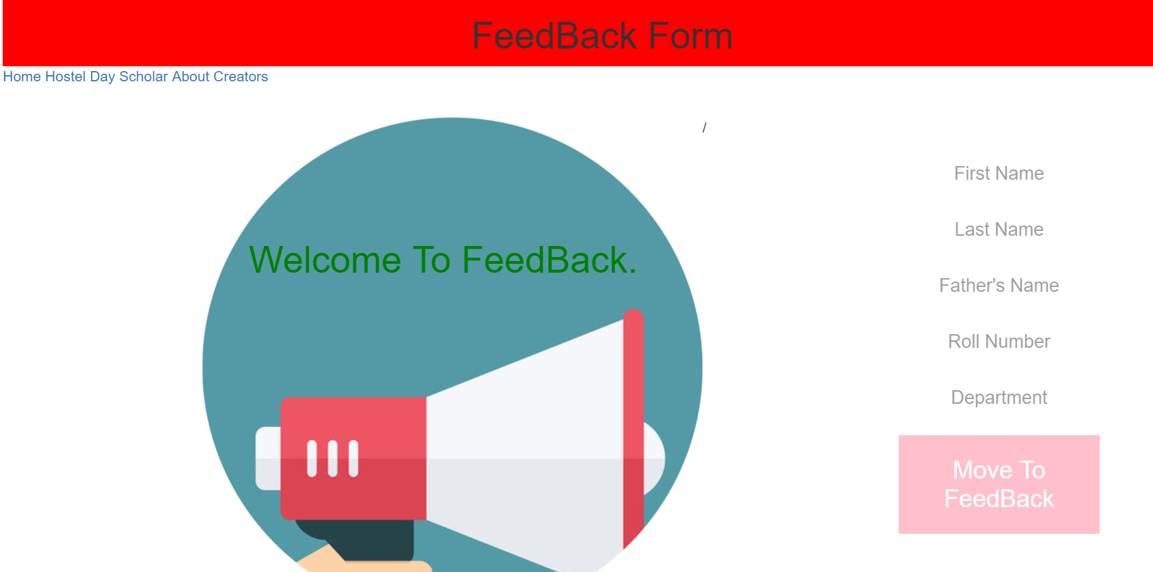
Page 1: Website
THIS IS THE LOGIN PORTAL OF OUR WEBSITE.

Slide 11
Login Portal
The user logs in to the website.
Fills the credentials.
Completes the feedback form.

Slide 12


Slide 13
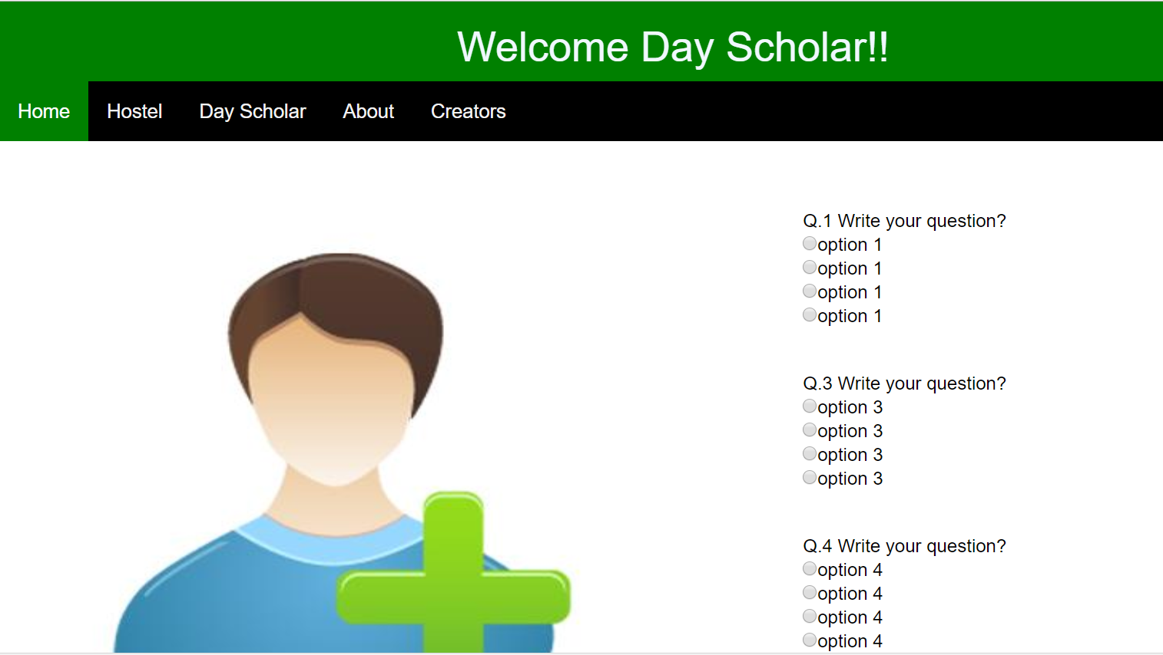
DAY SCHOLAR

Slide 14
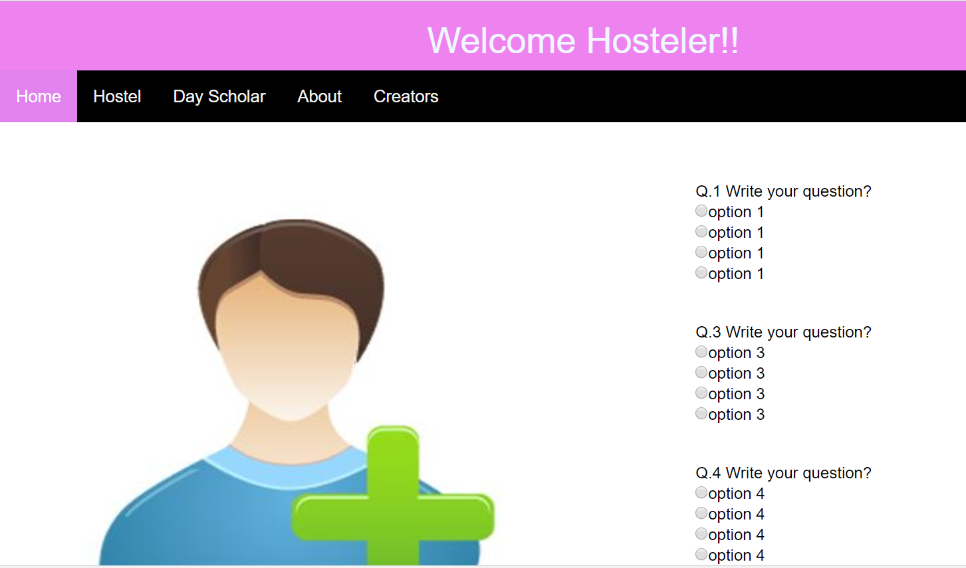
HOSTELER

Slide 15
ISSUES FACED BY STUDENTS
Day Scholars Common Issues:-
Transportation.
Time Management.
Lack of resources.
Hostelers Common Issues:-
1.Hygenic Problems.
2.Food related problems.
3.Adjustment problems.

Slide 16
HTML CODE FOR Hostel Feedback
<html>
<head><title>hostel</title>
<link rel="stylesheet"href="https://maxcdn.bootstrapcdn.com/bootstrap/3.3.7/css/bootstrap.min.css">
<script src="https://ajax.googleapis.com/ajax/libs/jquery/3.3.1/jquery.min.js"></script>
<script src="https://maxcdn.bootstrapcdn.com/bootstrap/3.3.7/js/bootstrap.min.js"></script>
<link rel="icon" href="icon.png">
<link rel="stylesheet" href="hostel.css">
<meta name="viewport" content="width=device-width, initial-scale=1.0">
<script>
function f(){
location.href="thank-you.html";}

Slide 17
</script>
</head>
<body>
<div class="container">
<div id="head" class="row text-center">
<h1> Welcome Hosteler!!</h1>
</div>
<div class="row nav">
<div class="topnav">
<a class="active" href="loglogin.html">Home</a>
<a href="https://www.chitkara.edu.in/?s=hostel">Hostel</a>
<a href="https://www.chitkara.edu.in/?s=day+scholar">Day Scholar</a>
<a href="https://www.chitkara.edu.in/">About</a>
<a href="creators.html">Creators</a>
</div>
</div>

Slide 18
<br><br><br>
<div class="row">
<div class="col-sm-6">
<div class="fix">
<img class="myimg" src="4.jpg">
<center><br>
</center><br><br>
</div>
</div>
<div class="col-sm-1"></div>
<div class="col-sm-5">
<table>
<tr><table>
<tr><td>Q.1 Write your question?</td></tr>
<tr><td><input type="radio" value="" name="opt1">option 1<br>
<input type="radio" value="" name="opt1">option 1<br>
<input type="radio" value="" name="opt1">option 1<br>
<input type="radio" value="" name="opt1">option 1<br></td></tr></table>
</tr>
<br><br>

Slide 19
<tr>
<table>
<tr><td>Q.3 Write your question?</td></tr>
<tr><td><input type="radio" value="" name="opt3">option 3<br>
<input type="radio" value="" name="opt3">option 3<br>
<input type="radio" value="" name="opt3">option 3<br>
<input type="radio" value="" name="opt3">option 3<br></td></tr>
</table>
</tr>
<br><br>
<tr>
<table>
<tr><td>Q.4 Write your question?</td></tr>
<tr><td><input type="radio" value="" name="opt4">option 4<br>
<input type="radio" value="" name="opt4">option 4<br>
<input type="radio" value="" name="opt4">option 4<br>
<input type="radio" value="" name="opt4">option 4<br></td></tr>
</table>

Slide 20
<br><br>
<table>
<tr><td>
Comments:
</td></tr>
<tr><td>
<textarea rows="7" cols="50" ></textarea>
<br><br>
</td></tr>
</table>
<table>
<tr><td><button onclick="f()">SUBMIT</button></td>
<td><button>RESET</button></td>
</tr>
</table>
</div></div>
<br><br>
<div class="row bottom">
</div>
</div>
</body></html>

Slide 21
CODE FOR DAY SCHOLAR:
<html>
<head><title>index</title>
<meta name="viewport" content="width=device-width, initial-scale=1.0">
<link rel="stylesheet" href="https://maxcdn.bootstrapcdn.com/bootstrap/3.3.7/css/bootstrap.min.css">
<script src="https://ajax.googleapis.com/ajax/libs/jquery/3.3.1/jquery.min.js"></script>
<script src="https://maxcdn.bootstrapcdn.com/bootstrap/3.3.7/js/bootstrap.min.js"></script>
<link rel="stylesheet" href="scholar.css">
<link rel="icon" href="icon.png"><style>

Slide 22
#main{
background-color: #4caf50;
}
h2{
color:red;}
</style>
</head>
<body>
<div class="container">
<div class="row text-center" id="main">
<h1>FeedBack Form</h1>
</div>
<div class="topnav">
<a class="active" href="loglogin.html">Home</a>
<a href="https://www.chitkara.edu.in/?s=hostel">Hostel</a>
<a href="scholar.html">Day Scholar</a>
<a href="https://www.chitkara.edu.in/">About</a>
<a href="creators.html">Creators</a>
</div>
</div>

Slide 23
<div class="row text-center" class="partition">
<div class="col-sm-6 left" id="h" value="Hosteler" >
<br><br><br>
<img src=''/>
</div>
<div class="col-sm-6 right" id="ds" value="Day Scholar">
<h2>Day Scholars</h2>

Slide 24
Conclusion
This project is design for the purpose to overcome the problems faced by the students in the college . At the time of feedback generation it apply formulae for generate a feedback of particular subject. After that it will displayed the whole record sheet to the staff, when the staff will login in the system. As the comparison with Manuel feedback or existing feedback system the new system is easier way to manage whole things in a particular manner. As per the existing system it is very easy process to save each and every record of individual student by the use of database.

Slide 25
Future Scope:-
Future Scope Of Application:
This application can be easily implemented under various situations. We can add new features as and when we require. Reusability is possible as and when require in this application. There is flexibility in all the modules.
Software scope:
Extensibility
Reusability
Understandability
Cost-effectiveness

Slide 26
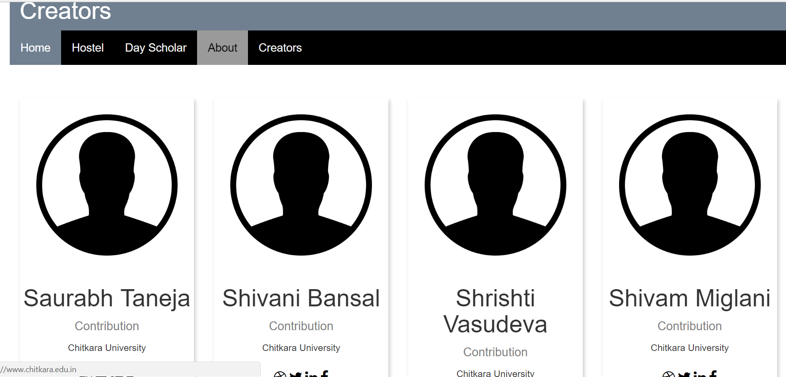
CREATERS WEBPAGE

Slide 27
Bibliography/References:-
www.W3schools.com
www.Tutorialpoints.com
www.Youtube.com
www.codeschool.com
Teach Yourself PHP By Matt Zandstra
Beginning PHP By Matt Doyle

Slide 28

This Photo by Unknown Author is licensed under CC BY

